Slide 1
Auto Regressive Moving Average models
The specifics of using the autoregressive (AR); moving average (MA) and joined ARMA model;
Integrated ARMA model and its use in time series analysis;
Seasonal integrated ARMA model and its use in time series analysis;
Features of the choice of the order of the ARMA and others models;
Review of other ARMA-based models;
Examples of solving problems of time series analysis using ARMA.

Slide 2
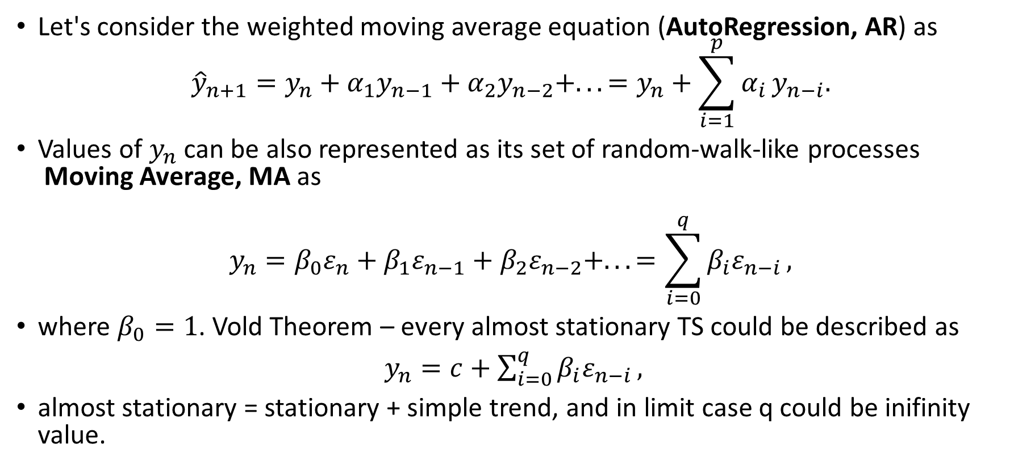
AutoRegressive Moving Average model (ARMA)
Let's consider the weighted moving average equation (AutoRegression, AR) as
$${\hat{y}}_{n+1}=y_{n}+α_{1}y_{n−1}+α_{2}y_{n−2}+...=y_{n}+\sum_{i=1}^{p}{α_{i}}y_{n−i}.$$
Values of $y_{n}$ can be also represented as its set of random-walk-like processes Moving Average, MA as
$$y_{n}=β_{0}ε_{n}+β_{1}ε_{n−1}+β_{2}ε_{n−2}+...=\sum_{i=0}^{q}{β_{i}ε_{n−i}},$$
where $β_{0}=1$. Vold Theorem – every almost stationary TS could be described as
$y_{n}=c+\sum_{i=0}^{q}{β_{i}ε_{n−i}},$
almost stationary = stationary + simple trend, and in limit case q could be inifinity value.

Slide 3
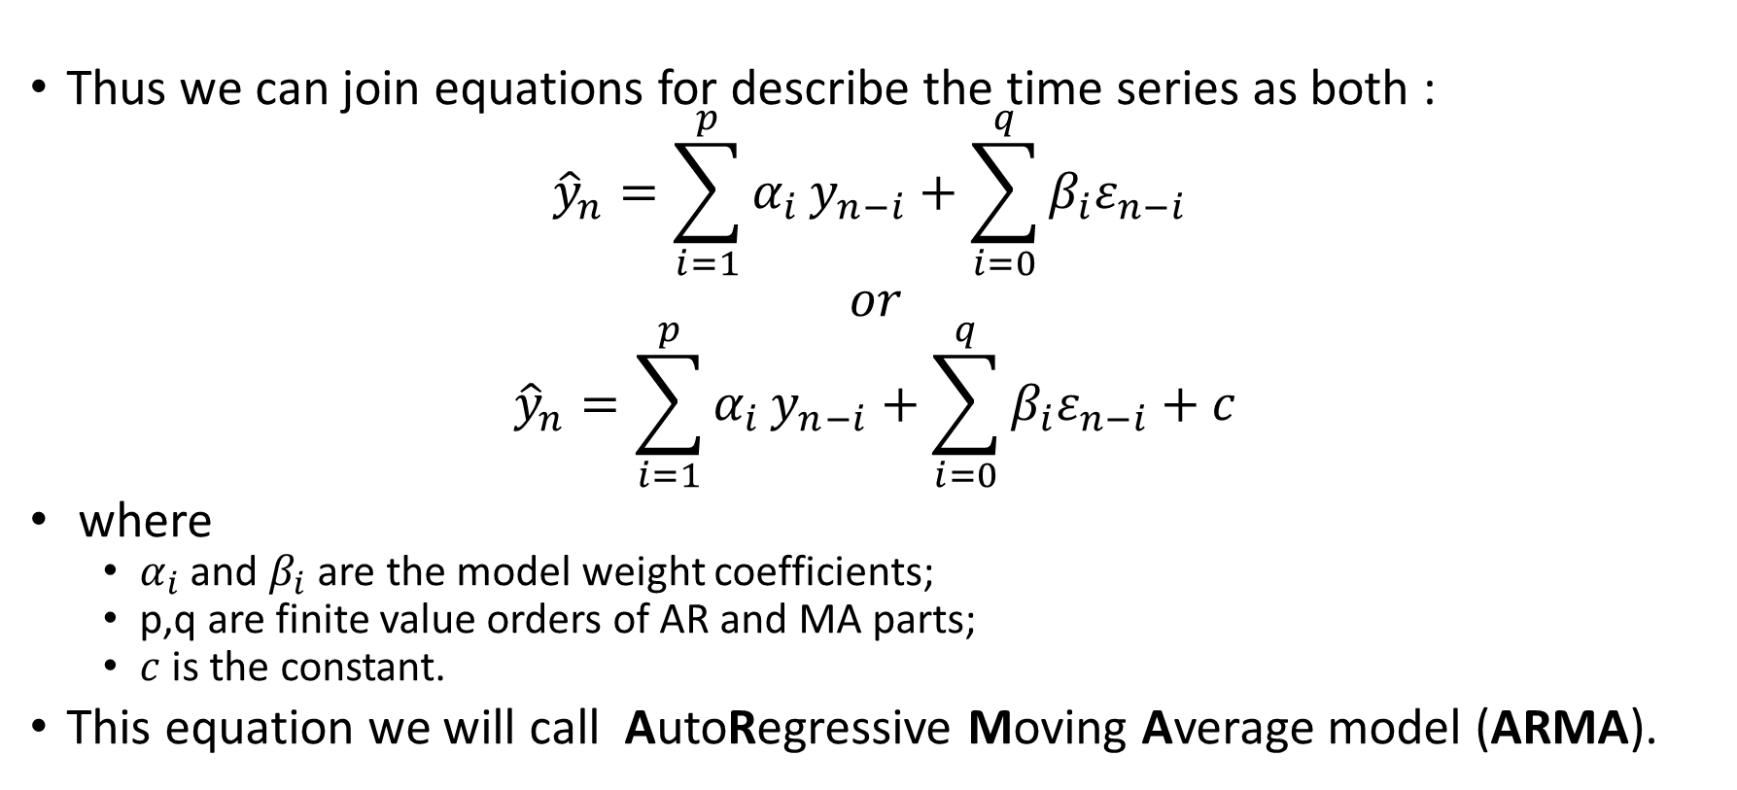
AutoRegressive Moving Average model (ARMA)
Thus we can join equations for describe the time series as both :
$${\hat{y}}_{n}=\sum_{i=1}^{p}{α_{i}}y_{n−i}+\sum_{i=0}^{q}{β_{i}ε_{n−i}}$$
$$or$$
$${\hat{y}}_{n}=\sum_{i=1}^{p}{α_{i}}y_{n−i}+\sum_{i=0}^{q}{β_{i}ε_{n−i}}+c$$
where
$α_{i}$ and $β_{i}$ are the model weight coefficients;
p,q are finite value orders of AR and MA parts;
$c$ is the constant.
This equation we will call AutoRegressive Moving Average model (ARMA).

Slide 4
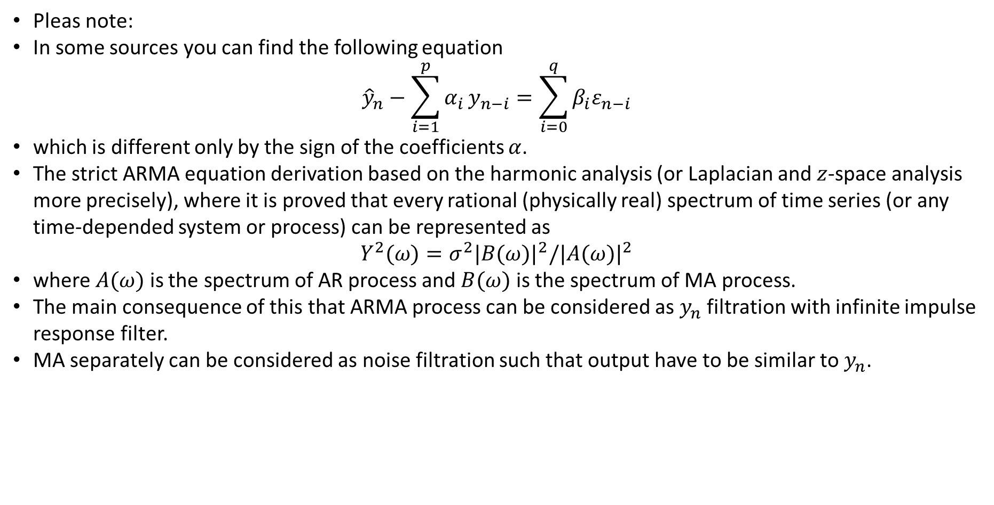
AutoRegressive Moving Average model (ARMA)
Pleas note:
In some sources you can find the following equation
$${\hat{y}}_{n}−\sum_{i=1}^{p}{α_{i}}y_{n−i}=\sum_{i=0}^{q}{β_{i}ε_{n−i}}$$
which is different only by the sign of the coefficients $α$.
The strict ARMA equation derivation based on the harmonic analysis (or Laplacian and $z$-space analysis more precisely), where it is proved that every rational (physically real) spectrum of time series (or any time-depended system or process) can be represented as
$$Y^{2}(ω)=σ^{2}|B(ω)|^{2}/|A(ω)|^{2}$$
where $A(ω)$ is the spectrum of AR process and $B(ω)$ is the spectrum of MA process.
The main consequence of this that ARMA process can be considered as $y_{n}$ filtration with infinite impulse response filter.
MA separately can be considered as noise filtration such that output have to be similar to $y_{n}$.

Slide 5
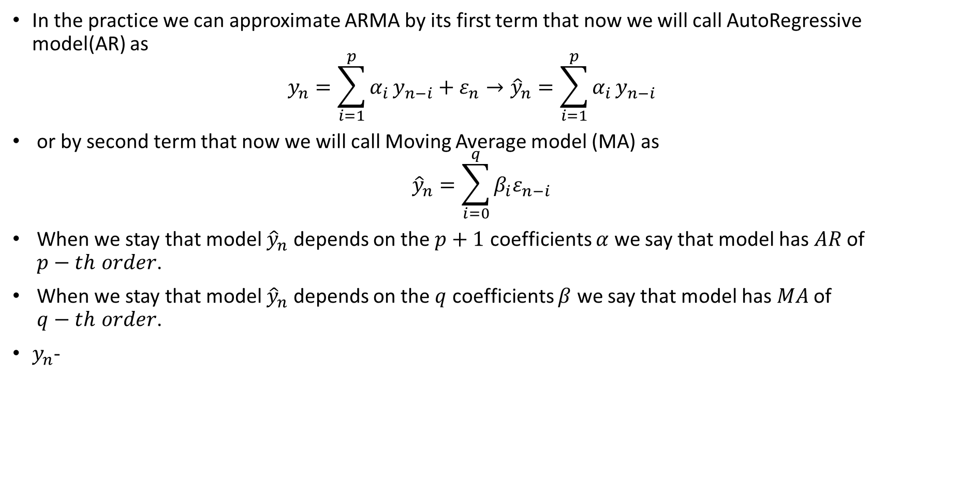
AutoRegressive Moving Average model (ARMA)
In the practice we can approximate ARMA by its first term that now we will call AutoRegressive model(AR) as $y_{n}=\sum_{i=1}^{p}{α_{i}}y_{n−i}+ε_{n}→{\hat{y}}_{n}=\sum_{i=1}^{p}{α_{i}}y_{n−i}$
or by second term that now we will call Moving Average model (MA) as ${\hat{y}}_{n}=\sum_{i=0}^{q}{β_{i}ε_{n−i}}$
When we stay that model ${\hat{y}}_{n}$ depends on the $p+1$ coefficients $α$ we say that model has $AR$ of $p−th order$.
When we stay that model ${\hat{y}}_{n}$ depends on the $q$ coefficients $β$ we say that model has $MA$ of $q−th order$.
$y_{n}$-

Slide 6
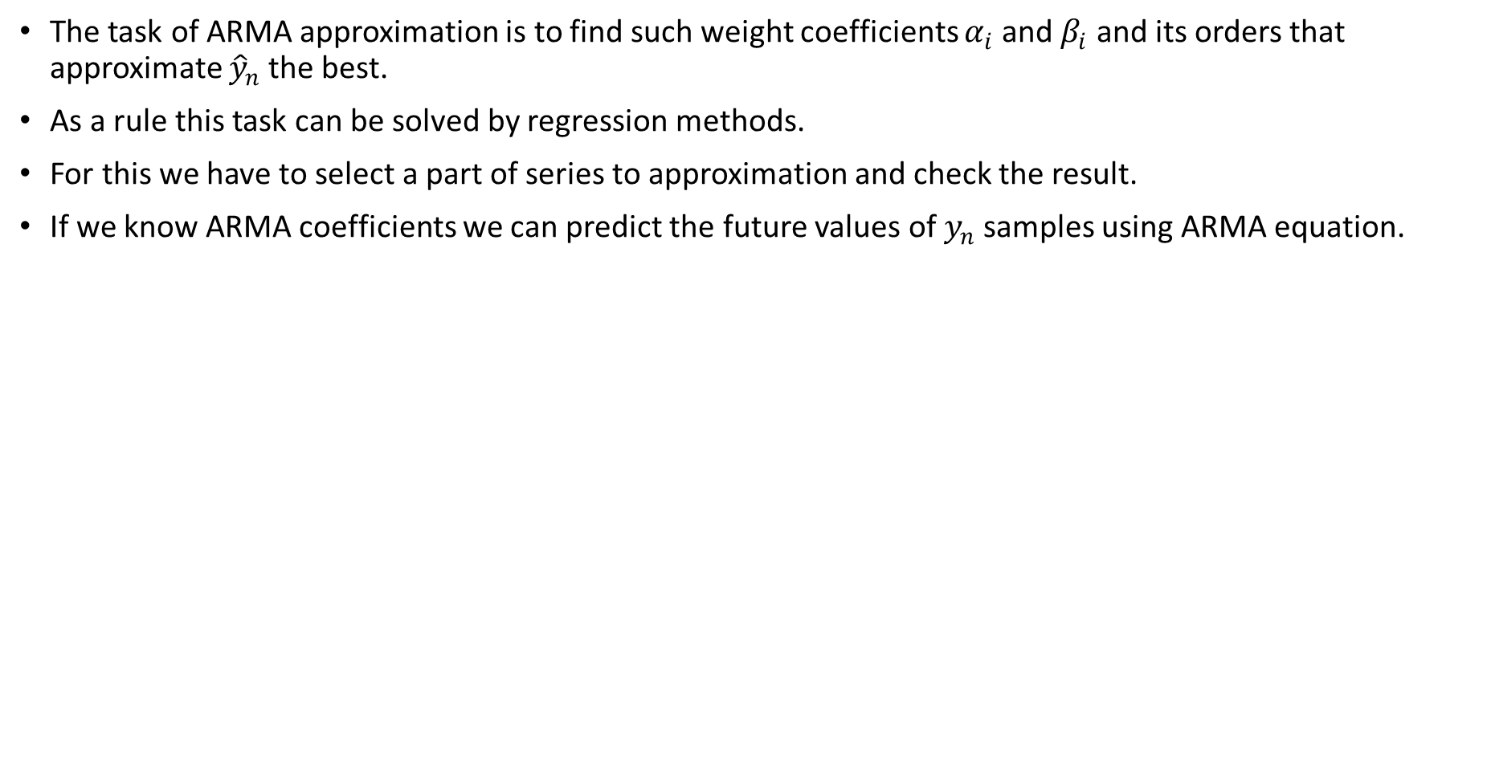
AutoRegressive Moving Average model (ARMA)
The task of ARMA approximation is to find such weight coefficients $α_{i}$ and $β_{i}$ and its orders that approximate ${\hat{y}}_{n}$ the best.
As a rule this task can be solved by regression methods.
For this we have to select a part of series to approximation and check the result.
If we know ARMA coefficients we can predict the future values of $y_{n}$ samples using ARMA equation.

Slide 7
ARMA Order Selection
After integration order selection the AR and MA orders need to be selected. It can be the following recommendations about it
ARMA order selection
ACF Pattern | PACF Pattern | Conclusion
Tapers to 0 in some fashion | Non-zero values at first p points; zero values elsewhere | AR(p) Model
Non-zero values at first q points; zero values elsewhere | Tapers to 0 in some fashion | MA(q) model
No significant correlations | No significant correlations | Random Series.

Slide 8
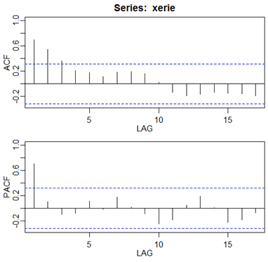
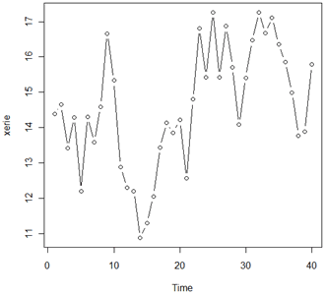
Example of Order Selection

Slide 9
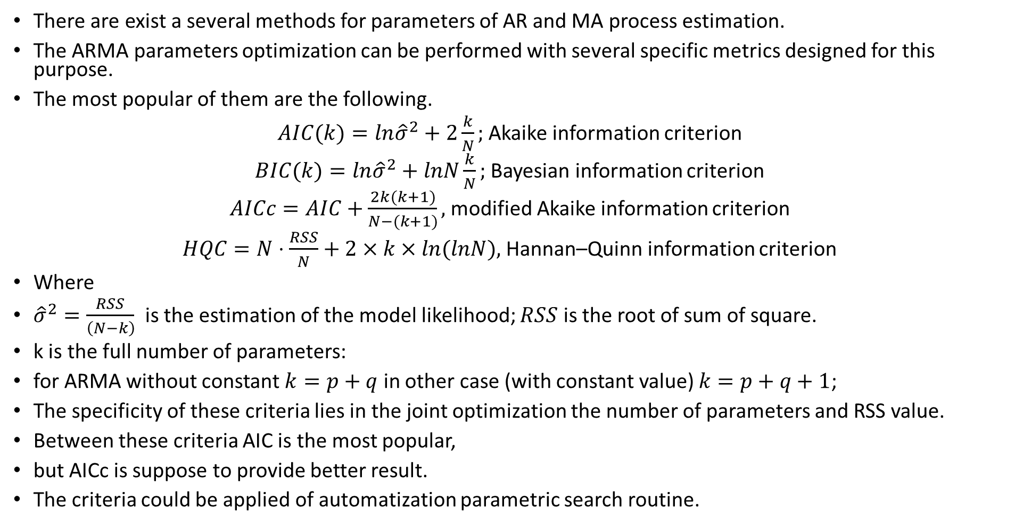
ARMA coefficient estimation
There are exist a several methods for parameters of AR and MA process estimation.
The ARMA parameters optimization can be performed with several specific metrics designed for this purpose.
The most popular of them are the following.
$AIC(k)=ln{\hat{σ}}^{2}+2\frac{k}{N};$ Akaike information criterion
$BIC(k)=ln{\hat{σ}}^{2}+lnN\frac{k}{N};$ Bayesian information criterion
$AICc=AIC+\frac{2k(k+1)}{N−(k+1)},$ modified Akaike information criterion
$HQC=N⋅\frac{RSS}{N}+2×k×ln(lnN),$ Hannan–Quinn information criterion
Where
${\hat{σ}}^{2}=\frac{RSS}{\left(N−k\right)}$ is the estimation of the model likelihood; $RSS$ is the root of sum of square.
k is the full number of parameters:
for ARMA without constant $k=p+q$ in other case (with constant value) $k=p+q+1$;
The specificity of these criteria lies in the joint optimization the number of parameters and RSS value.
Between these criteria AIC is the most popular,
but AICc is suppose to provide better result.
The criteria could be applied of automatization parametric search routine.

Slide 10
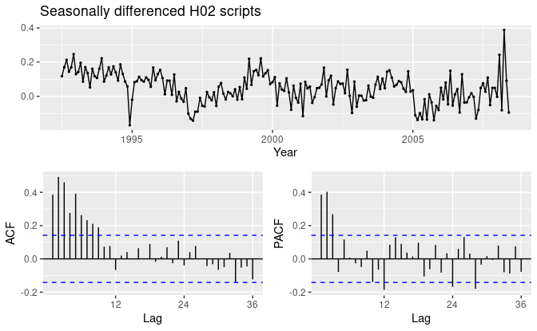
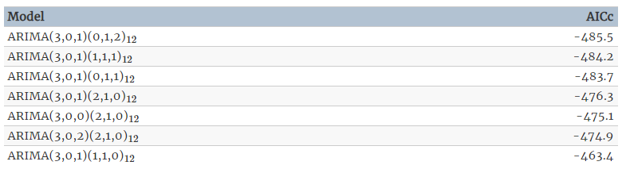
ARMA coefficient estimation Example
Example: sales prediction. On the original plot there is a small increase in the variance with the level, so we take logarithms to stabilize the variance.
The variations of parameters decline the first guess - it is better to use ARIMA(3,0,1)(0,1,2)12 model.
On the obtained plot there are spikes in the PACF at lags 12 and 24, but nothing at seasonal lags in the ACF. This may be suggestive of a SAR(2) term. In the non-seasonal lags, there are three significant spikes in the PACF, suggesting a possible AR(3) term. The pattern in the ACF is not indicative of any simple model.
This initial analysis suggests that a possible model for these data is an ARIMA(3,0,0)(2,1,0)12. The variations of parameters decline the first guess - it is better to use ARIMA(3,0,1)(0,1,2)12 model.

Slide 11
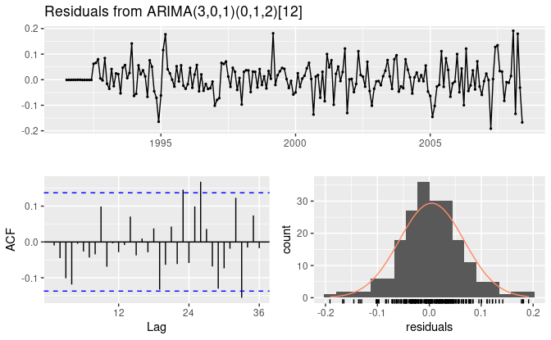
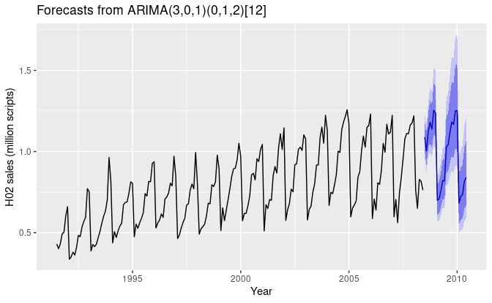
ARMA coefficient estimation Example Residual!
Example: sales prediction. On the original plot there is a small increase in the variance with the level, so we take logarithms to stabilize the variance.
Then it is need to estimate the residuals
Then it is need to estimate the residuals There are a few significant spikes in the ACF thus the model fails the Ljung-Box test. The model can still be used for forecasting, but the prediction intervals may not be accurate due to the correlated residuals.

Slide 12
Arma ALGORITHM
1 Make initial guess of orders based on the ACF and PACF
2 Check and select the best set of Orders by minimum of BIC or AICc or other criterion (variation of orders)
3 Check the residual of best model (compare with WGN)
4 Make validation of model

Slide 13
Auto Regressive Integrative Moving Average models

Slide 14
Autoregressive integrated moving average (ARIMA)
The main drawback of the ARMA process in the previously described form is the intrinsic stationary requirement, which lay in the routine of coefficient searching.
Indeed, if we require to obtain the best approximation (the smallest error) on the one part of the series - the series should be the similar (or have the similar behavior) for its future parts to ensure the same error.
Actually in Time series analysis for reducing (or eliminate) discussed requirement of stationary firstly we must reach the stationarity.
We can reduce task to stationary by trying some inversible transforms. As a rule, this can be done by taking the numerical derivative.
This model is called Autoregressive integrated moving average (ARIMA).

Slide 15
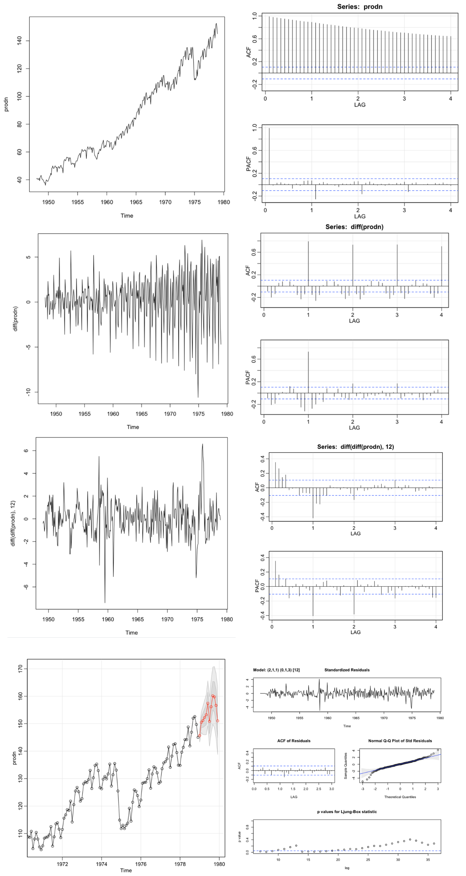
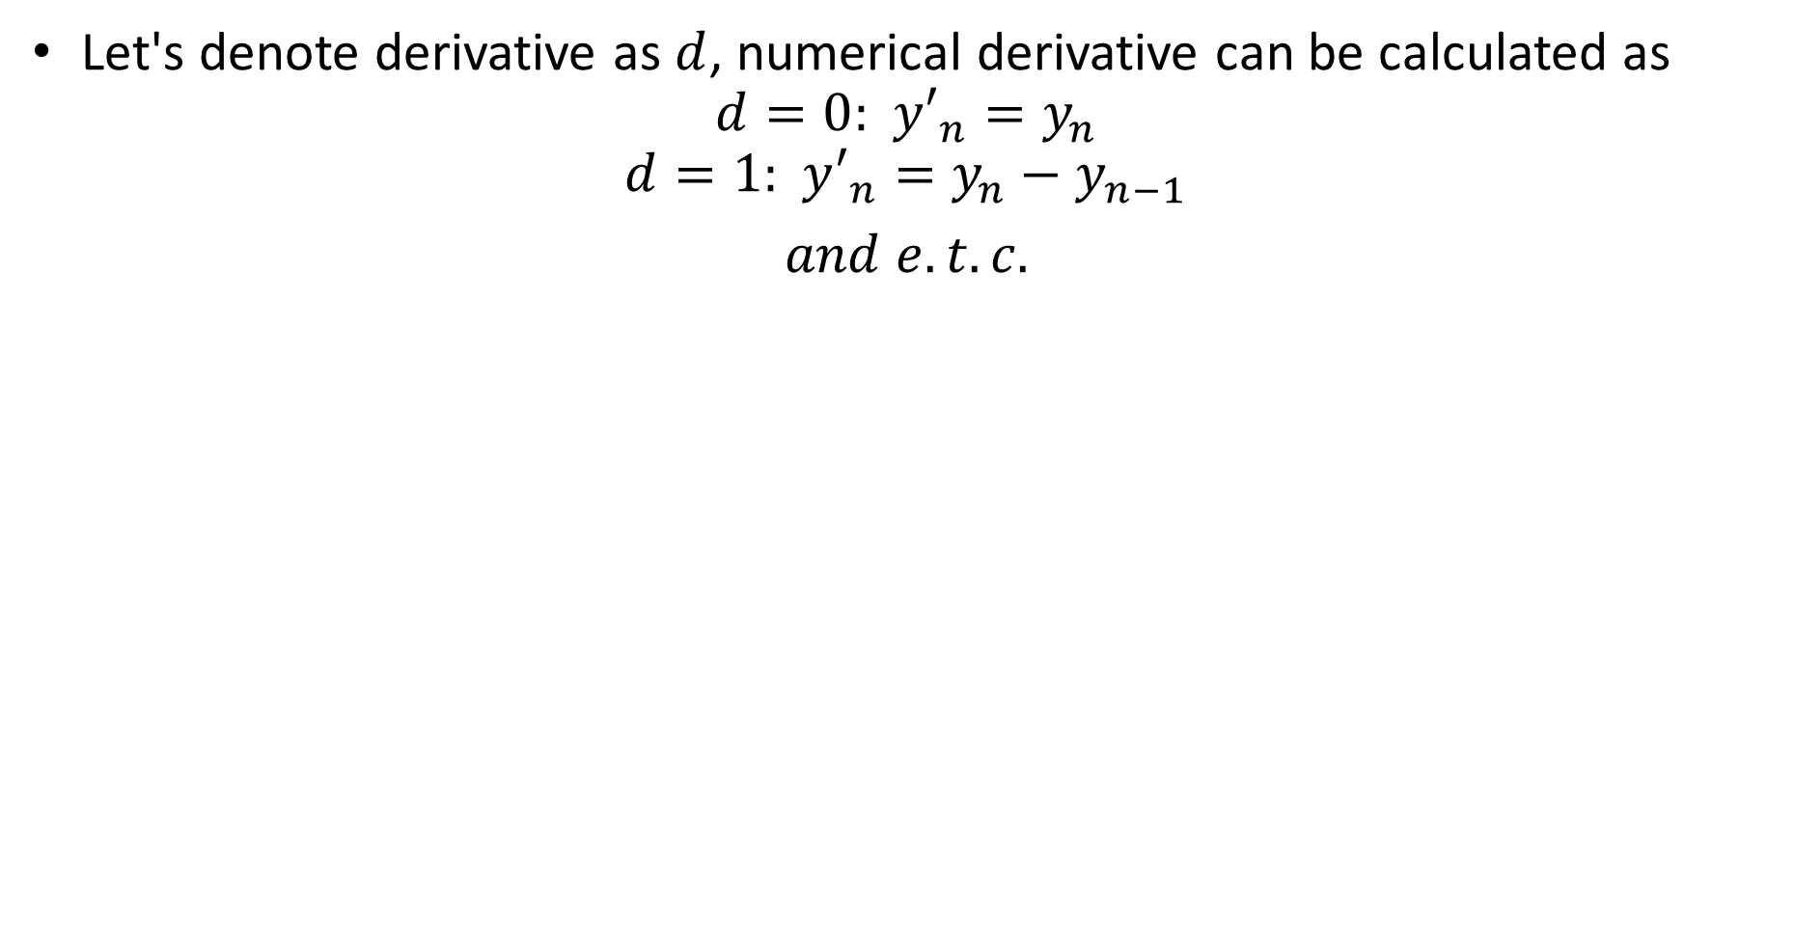
Lag form of ARIMA
Let's denote derivative as $d$, numerical derivative can be calculated as
$$d=0: y′_{n}=y_{n}$$
$$d=1: y′_{n}=y_{n}−y_{n−1}$$
$and e.t.c.$

Slide 16
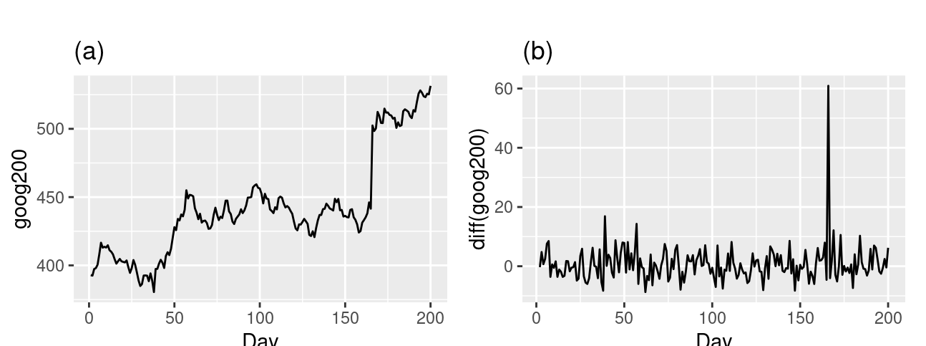
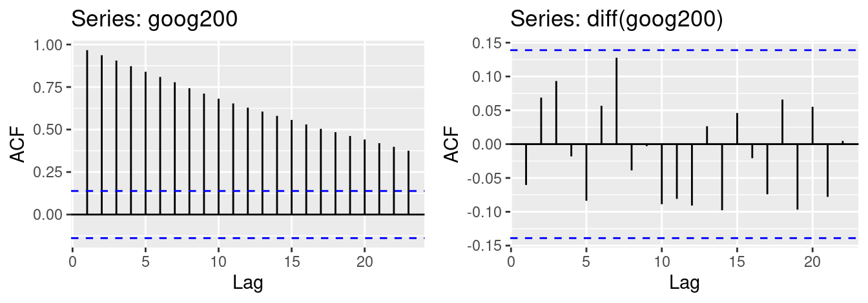
EXAMPLE

Slide 17
ARIMA stationarity
The first thing you need to do when work with ARIMA - is to determine derivation (to exclude trend and make data more stationary).
As a rule it is need to be 0-3 orders of derivative is applied, and rarely more.
For checking the stationarity it can be use a lot of statistical and visual techniques, among them:
Rolling Statistics: Plot the rolling mean and rolling standard deviation. The time series is stationary if they remain constant with time (with the naked eye look to see if the lines are straight and parallel to the x-axis). This technique corresponds to the weak definition of stationary.
ACF analysis (and PACF) - for the non-stationary process you will see slow decrease and other-wise for stationary. For stationary series autocorrelation function (ACF) plot decays fairly rapidly to zero or below.
Augmented Dickey-Fuller (ADF) Test: The time series is considered stationary by specific unit-root test, and the p-value is calculated also. If p-value is low (according to the null hypothesis) and the critical values at 1%, 5%, 10% confidence intervals are as close as possible to the ADF Statistics. P-value- statistical significant.
Kwiatkowski–Phillips–Schmidt–Shin (KPSS) test which is also unit-root test, but differs from ADF in the case of deterministic trend with inflection points.

Slide 18
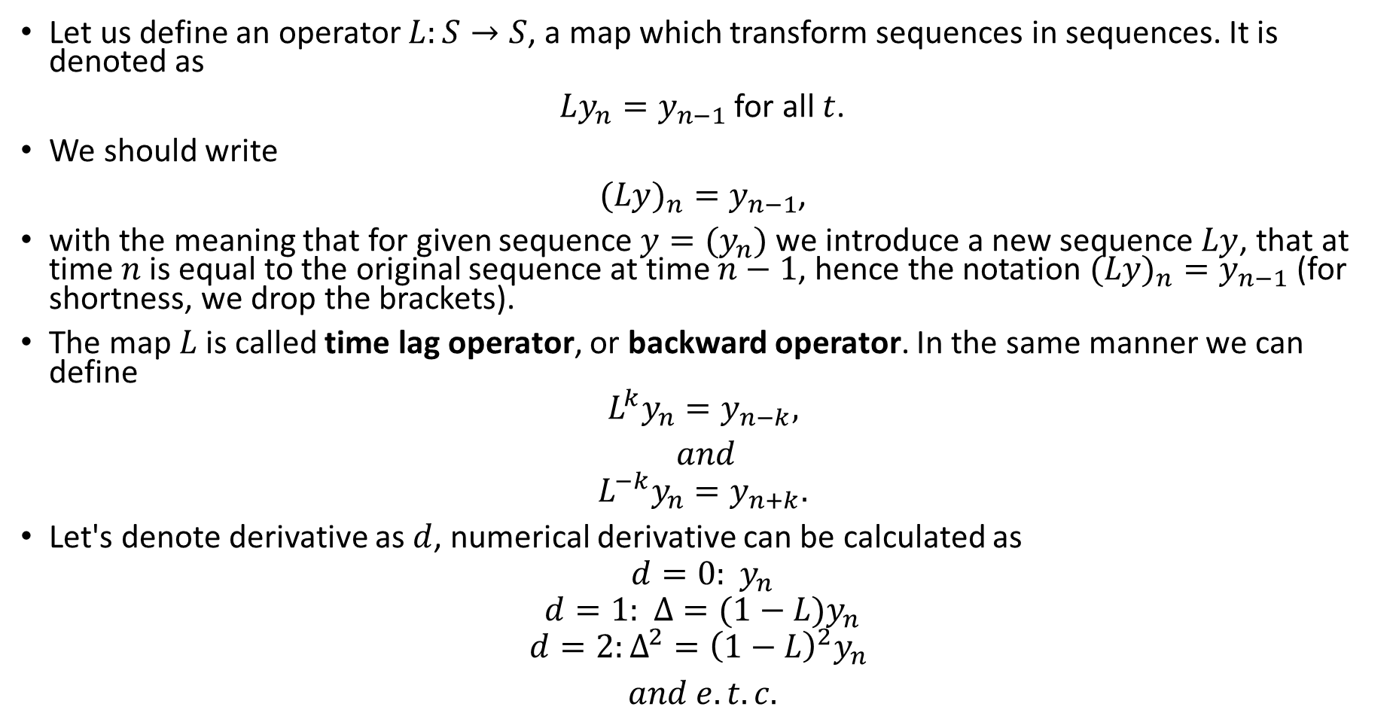
Lag form of ARIMA
Let us define an operator $L:S→S$, a map which transform sequences in sequences. It is denoted as
$Ly_{n}=y_{n−1}$ for all $t$.
We should write
$(Ly)_{n}=y_{n−1}$,
with the meaning that for given sequence $y=(y_{n})$ we introduce a new sequence $Ly$, that at time $n$ is equal to the original sequence at time $n−1$, hence the notation $(Ly)_{n}=y_{n−1}$ (for shortness, we drop the brackets).
The map $L$ is called time lag operator, or backward operator. In the same manner we can define
$$L^{k}y_{n}=y_{n−k},$$
$and$
$$L^{−k}y_{n}=y_{n+k}.$$
Let's denote derivative as $d$, numerical derivative can be calculated as
$$d=0: y_{n}$$
$$d=1: Δ=(1−L)y_{n}$$
$$d=2:Δ^{2}={\left(1−L\right)}^{2}y_{n}$$
$and e.t.c.$

Slide 19
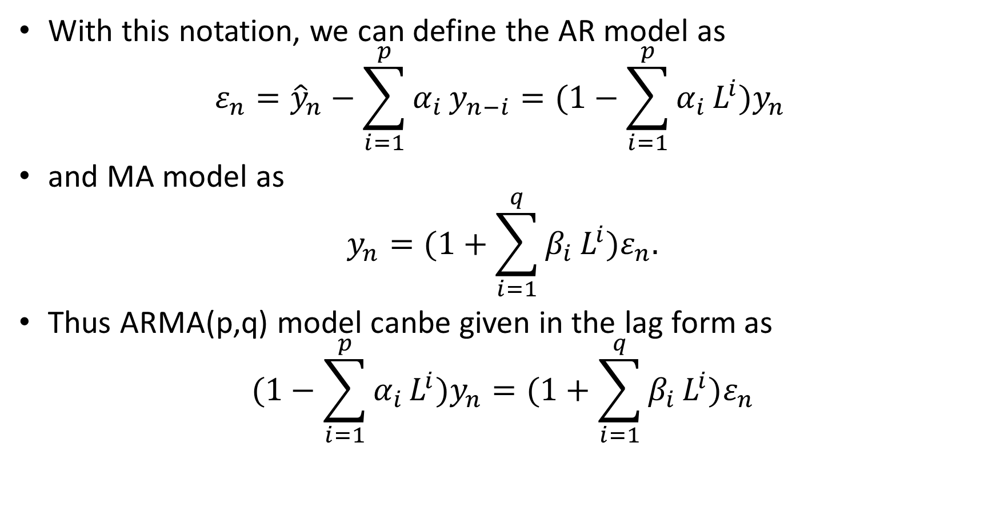
Lag operator form of ARIMA
With this notation, we can define the AR model as
$$ε_{n}={\hat{y}}_{n}−\sum_{i=1}^{p}{α_{i}}y_{n−i}=(1−\sum_{i=1}^{p}{α_{i}}L^{i})y_{n}$$
and MA model as
$$y_{n}=(1+\sum_{i=1}^{q}{β_{i}}L^{i})ε_{n}.$$
Thus ARMA(p,q) model canbe given in the lag form as
$$(1−\sum_{i=1}^{p}{α_{i}}L^{i})y_{n}=(1+\sum_{i=1}^{q}{β_{i}}L^{i})ε_{n}$$

Slide 20
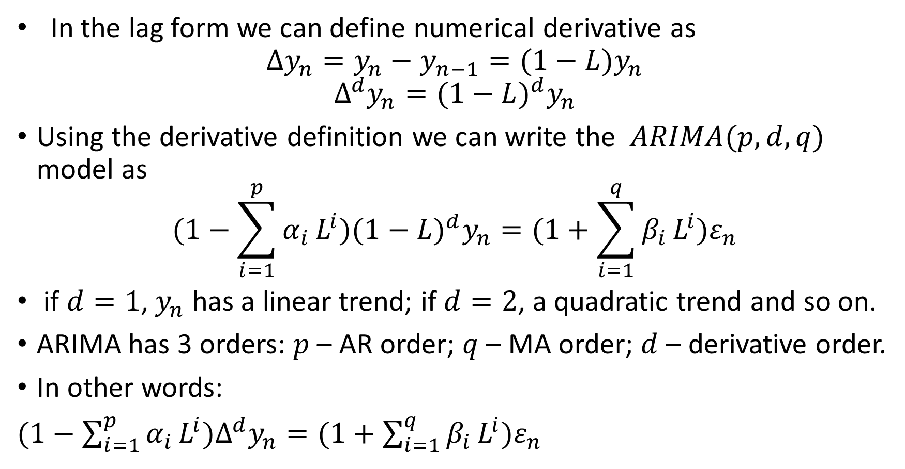
Lag operator form of ARIMA
In the lag form we can define numerical derivative as
$$Δy_{n}=y_{n}−y_{n−1}=(1−L)y_{n}$$
$$Δ^{d}y_{n}=(1−L)^{d}y_{n}$$
Using the derivative definition we can write the $ARIMA(p,d,q)$ model as
$$(1−\sum_{i=1}^{p}{α_{i}}L^{i})(1−L)^{d}y_{n}=(1+\sum_{i=1}^{q}{β_{i}}L^{i})ε_{n}$$
if $d=1$, $y_{n}$ has a linear trend; if $d=2$, a quadratic trend and so on.
ARIMA has 3 orders: $p$ – AR order; $q$ – MA order; $d$ – derivative order.
In other words:
$(1−\sum_{i=1}^{p}{α_{i}}L^{i}{)Δ}^{d}y_{n}=(1+\sum_{i=1}^{q}{β_{i}}L^{i})ε_{n}$

Slide 21
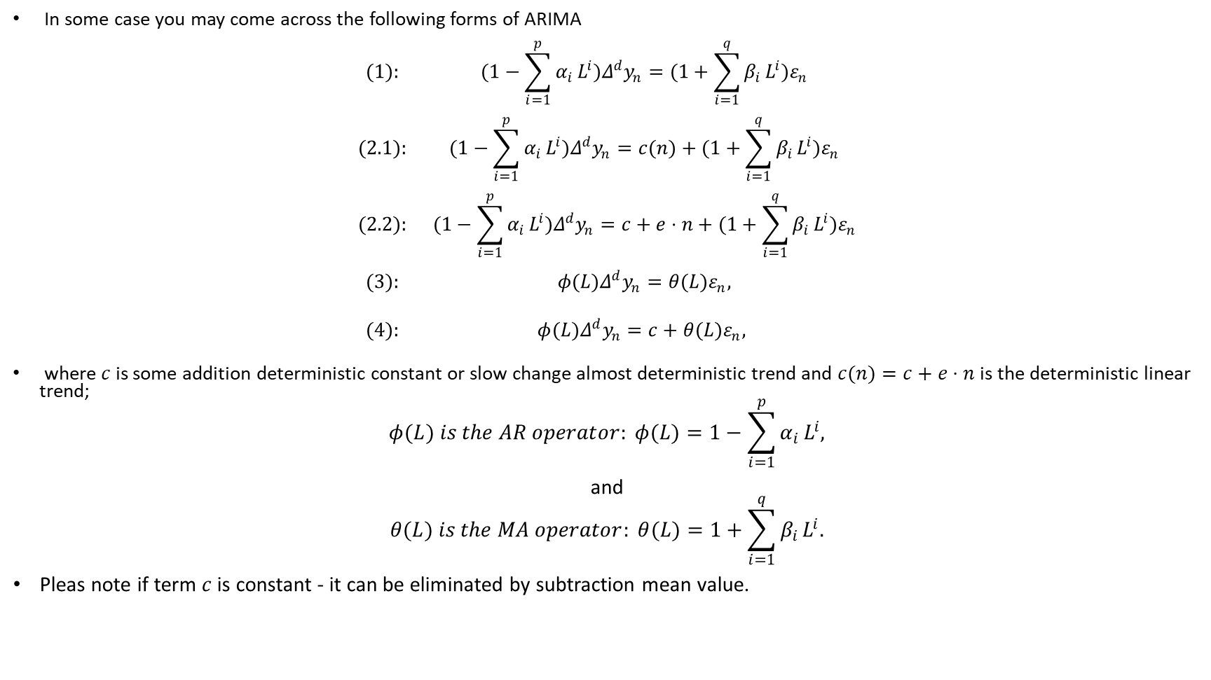
Lag form of ARIMA
In some case you may come across the following forms of ARIMA
$$\begin{matrix}(1): & (1−\sum_{i=1}^{p}{α_{i}}L^{i})Δ^{d}y_{n}=(1+\sum_{i=1}^{q}{β_{i}}L^{i})ε_{n} \\ & \\ (2.1): & (1−\sum_{i=1}^{p}{α_{i}}L^{i})Δ^{d}y_{n}=c(n)+(1+\sum_{i=1}^{q}{β_{i}}L^{i})ε_{n} \\ & \\ (2.2): & (1−\sum_{i=1}^{p}{α_{i}}L^{i})Δ^{d}y_{n}=c+e⋅n+(1+\sum_{i=1}^{q}{β_{i}}L^{i})ε_{n} \\ & \\ (3): & φ(L)Δ^{d}y_{n}=θ(L)ε_{n}, \\ & \\ (4): & φ(L)Δ^{d}y_{n}=c+θ(L)ε_{n}, \\ & \end{matrix}$$
where $c$ is some addition deterministic constant or slow change almost deterministic trend and $c(n)=c+e⋅n$ is the deterministic linear trend;
$$φ(L) is the AR operator: φ(L)=1−\sum_{i=1}^{p}{α_{i}}L^{i},$$
and
$$θ(L) is the MA operator: θ(L)=1+\sum_{i=1}^{q}{β_{i}}L^{i}.$$
Pleas note if term $c$ is constant - it can be eliminated by subtraction mean value.

Slide 22
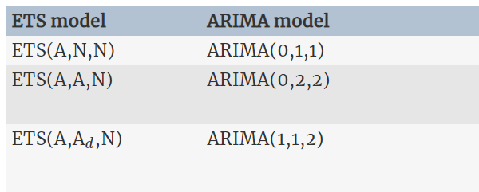
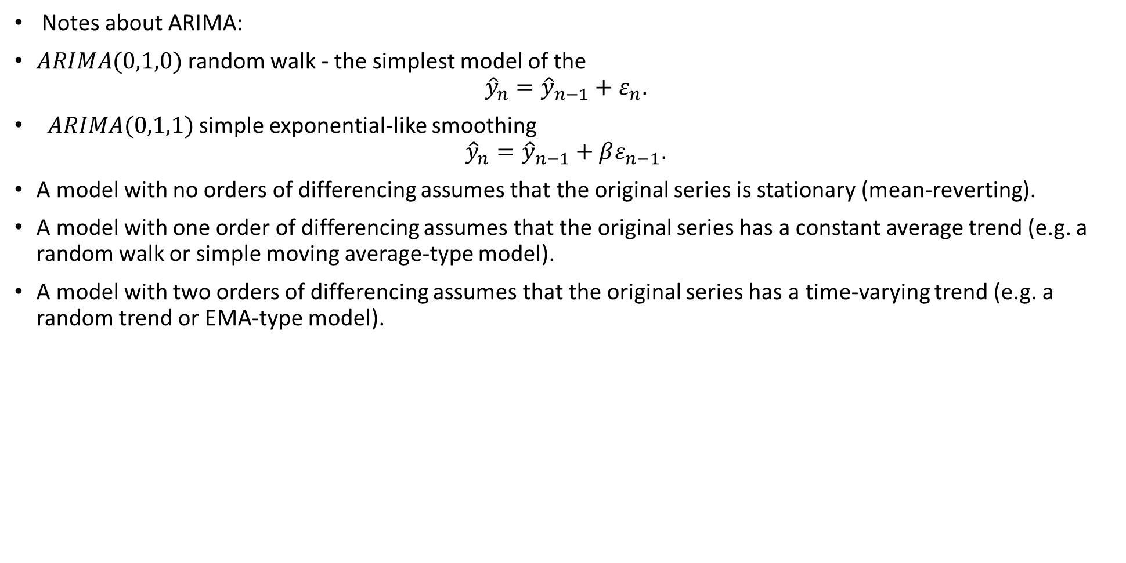
ARIMA
Notes about ARIMA:
$ARIMA(0,1,0)$ random walk - the simplest model of the
$${\hat{y}}_{n}={\hat{y}}_{n−1}+ε_{n}.$$
$ARIMA(0,1,1)$ simple exponential-like smoothing
$${\hat{y}}_{n}={\hat{y}}_{n−1}+βε_{n−1}.$$
A model with no orders of differencing assumes that the original series is stationary (mean-reverting).
A model with one order of differencing assumes that the original series has a constant average trend (e.g. a random walk or simple moving average-type model).
A model with two orders of differencing assumes that the original series has a time-varying trend (e.g. a random trend or EMA-type model).
Here are the matching table between ETS and some SARIMA models
PLEASE, NOTE, ARIMA described only additive models or additive with dumping models.
In other case use first some transforms! (like log)

Slide 23
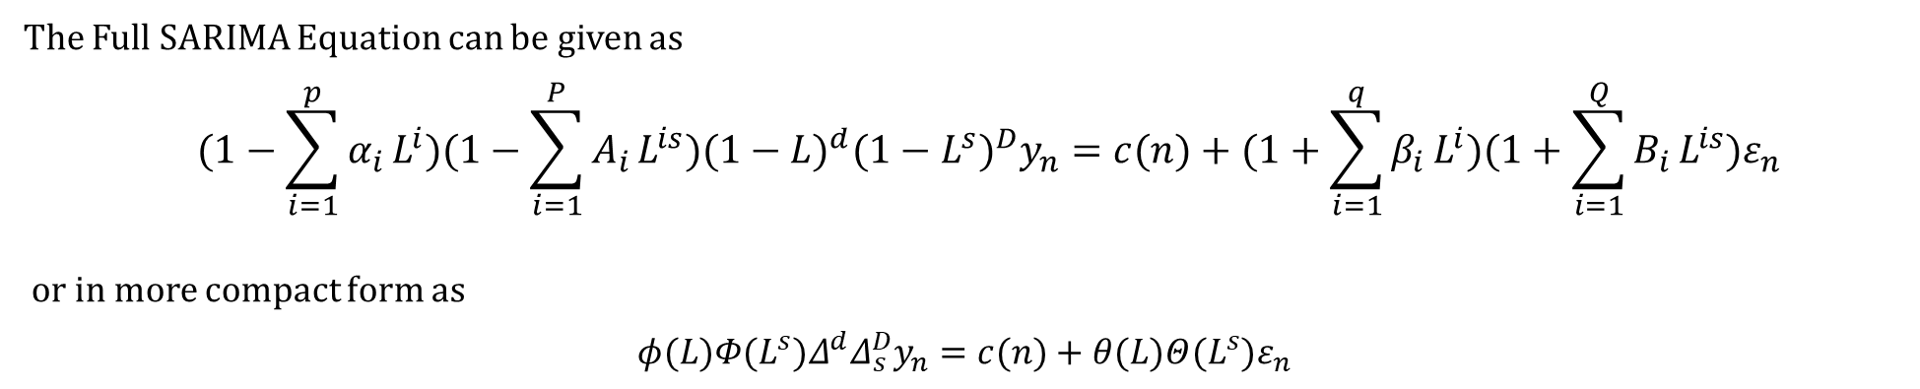
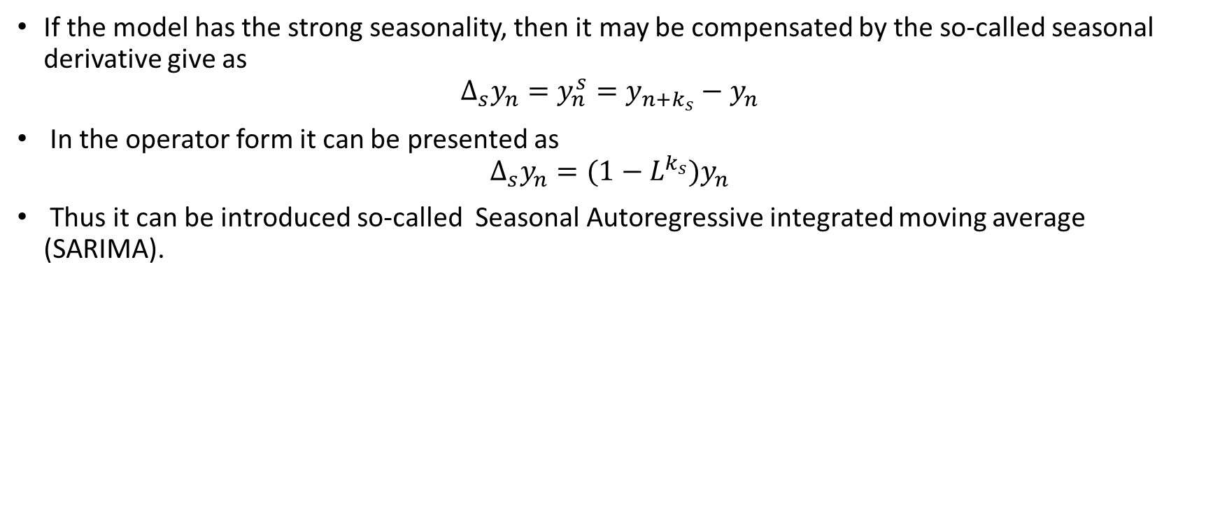
Seasonal Autoregressive Integrated Moving Average (SARIMA).
If the model has the strong seasonality, then it may be compensated by the so-called seasonal derivative give as
$$Δ_{s}y_{n}=y_{n}^{s}=y_{n+k_{s}}−y_{n}$$
In the operator form it can be presented as
$$Δ_{s}y_{n}=(1−L^{k_{s}})y_{n}$$
Thus it can be introduced so-called Seasonal Autoregressive integrated moving average (SARIMA).
The Full SARIMA Equation can be given as
$$\begin{matrix} & (1−\sum_{i=1}^{p}{α_{i}}L^{i})(1−\sum_{i=1}^{P}{A_{i}}L^{is})(1−L)^{d}(1−L^{s})^{D}y_{n}=c(n)+(1+\sum_{i=1}^{q}{β_{i}}L^{i})(1+\sum_{i=1}^{Q}{B_{i}}L^{is})ε_{n} \\ & \end{matrix}$$
or in more compact form as
$$φ(L)Φ(L^{s})Δ^{d}Δ_{s}^{D}y_{n}=c(n)+θ(L)Θ(L^{s})ε_{n}$$
Pleas note that derivate are taken only of AR part.

Slide 24
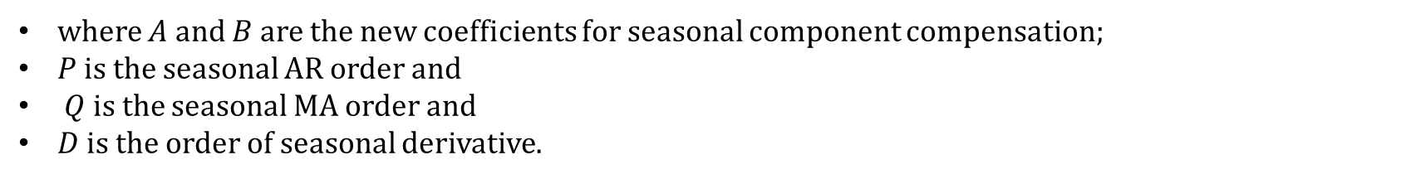
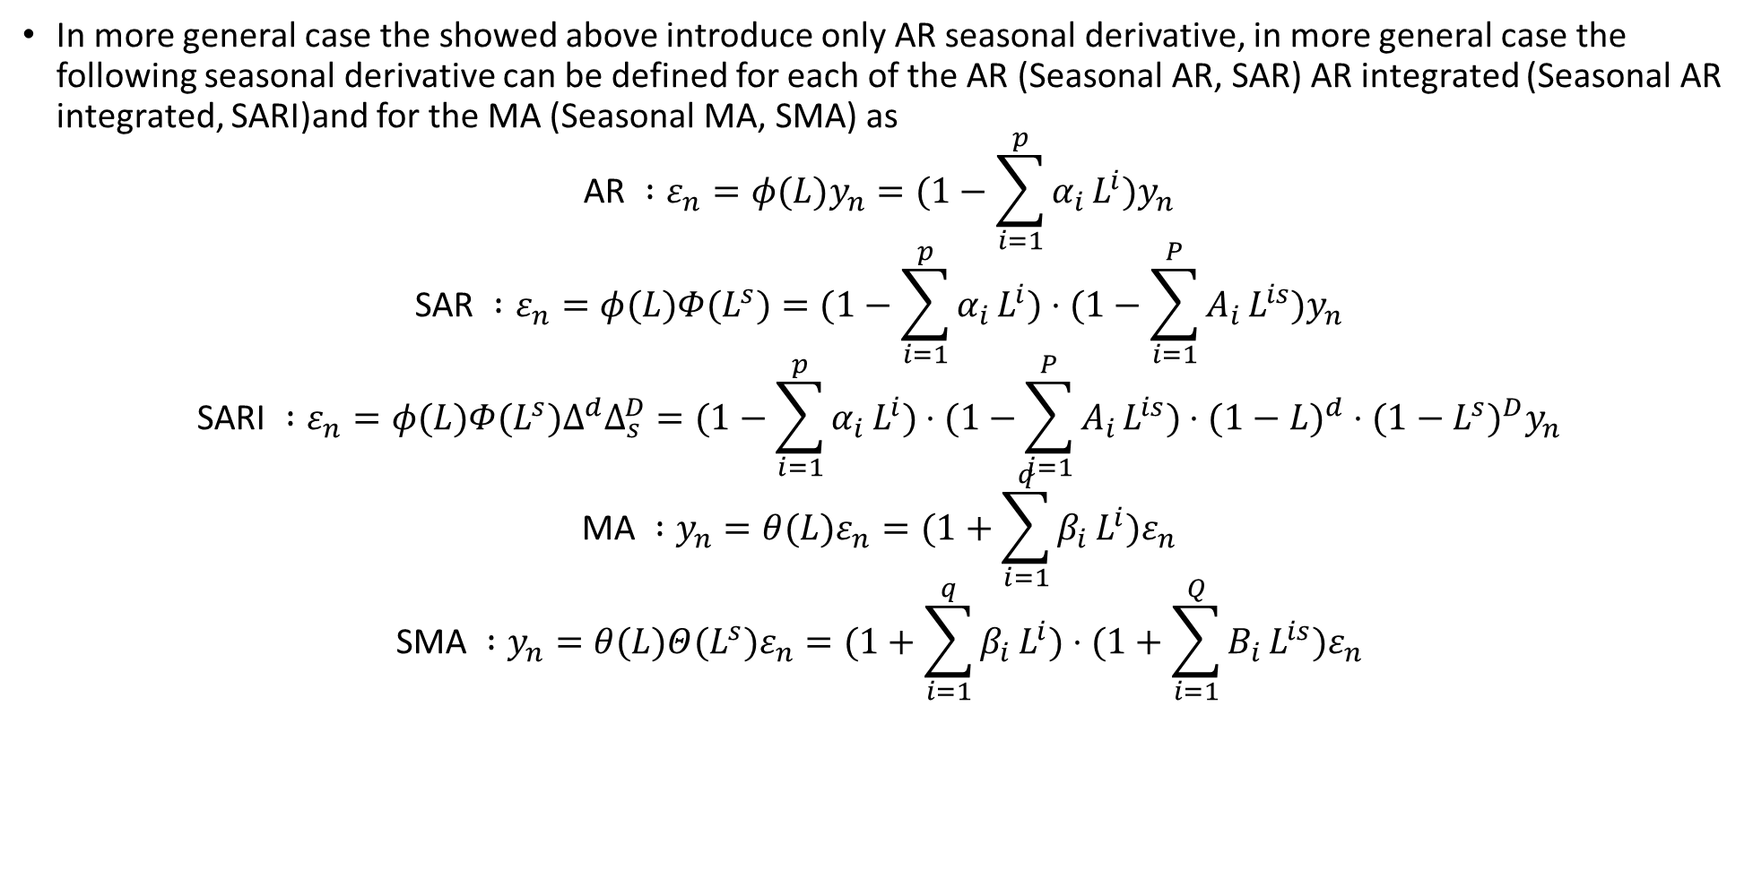
SARIMA Forms
In more general case the showed above introduce only AR seasonal derivative, in more general case the following seasonal derivative can be defined for each of the AR (Seasonal AR, SAR) AR integrated (Seasonal AR integrated, SARI)and for the MA (Seasonal MA, SMA) as
$$\text{AR} :ε_{n}=φ(L)y_{n}=(1−\sum_{i=1}^{p}{α_{i}}L^{i})y_{n}$$
$$\text{SAR} :ε_{n}=φ(L)Φ(L^{s})=(1−\sum_{i=1}^{p}{α_{i}}L^{i})⋅(1−\sum_{i=1}^{P}{A_{i}}L^{is})y_{n}$$
$$\text{SARI} :ε_{n}=φ(L)Φ(L^{s})Δ^{d}Δ_{s}^{D}=(1−\sum_{i=1}^{p}{α_{i}}L^{i})⋅(1−\sum_{i=1}^{P}{A_{i}}L^{is})⋅(1−L)^{d}⋅(1−L^{s})^{D}y_{n}$$
$$\text{MA} :y_{n}=θ(L)ε_{n}=(1+\sum_{i=1}^{q}{β_{i}}L^{i})ε_{n}$$
$$\text{SMA} :y_{n}=θ(L)Θ(L^{s})ε_{n}=(1+\sum_{i=1}^{q}{β_{i}}L^{i})⋅(1+\sum_{i=1}^{Q}{B_{i}}L^{is})ε_{n}$$
where $A$ and $B$ are the new coefficients for seasonal component compensation;
$P$ is the seasonal AR order and
$Q$ is the seasonal MA order and
$D$ is the order of seasonal derivative.

Slide 25
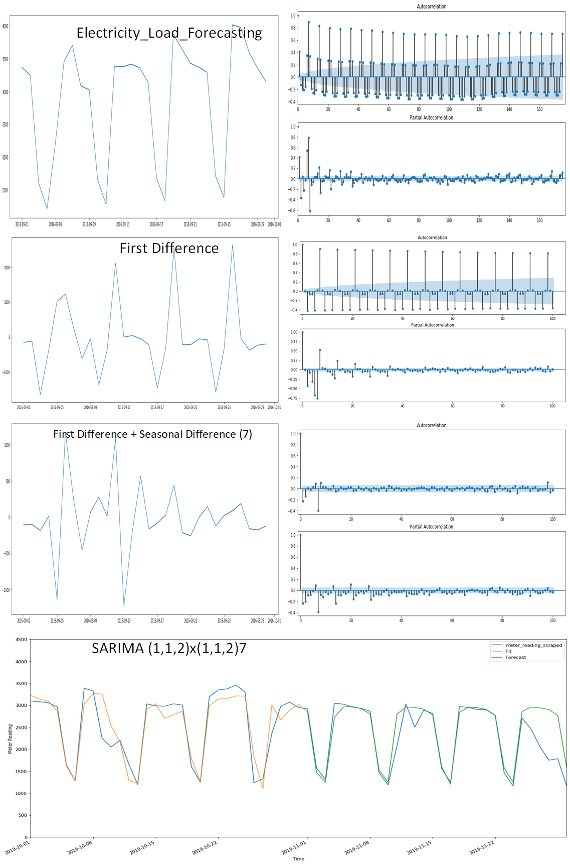
SARIMA Example

Slide 26
SARIMA Example

Slide 27
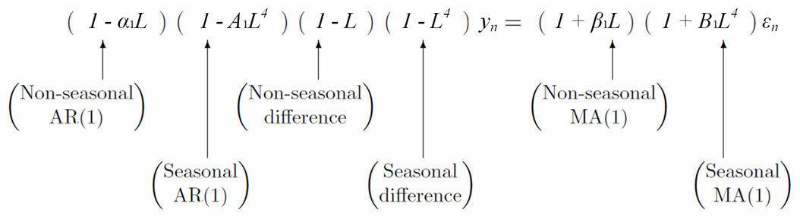
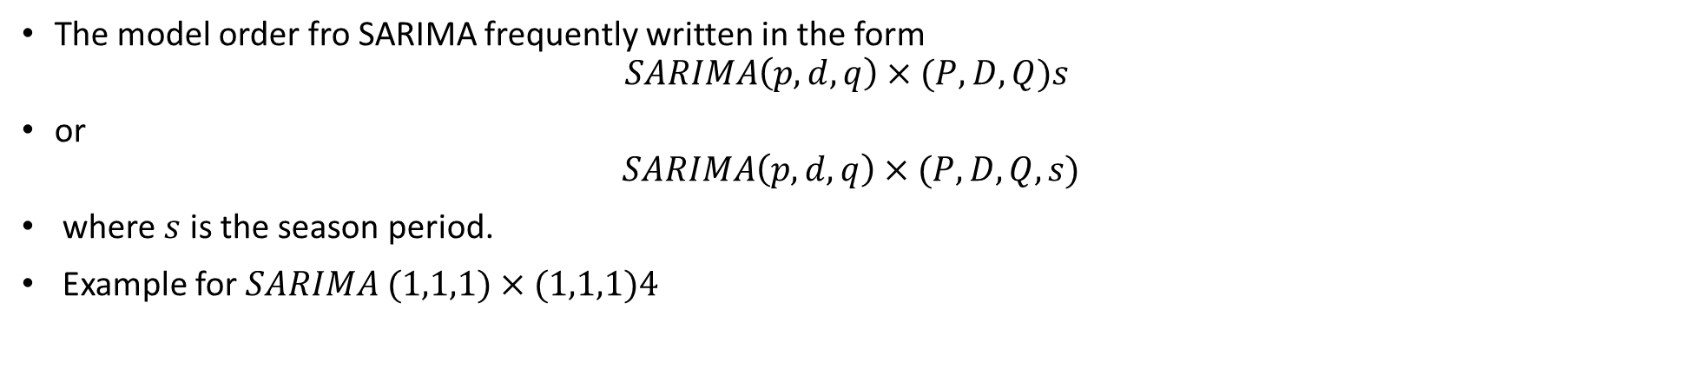
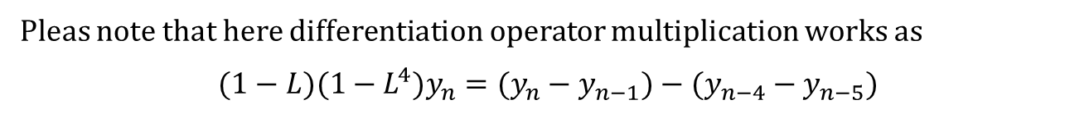
SARIMA Example
The model order fro SARIMA frequently written in the form
$$SARIMA\left(p,d,q\right)×(P,D,Q)s$$
or
$$SARIMA\left(p,d,q\right)×(P,D,Q,s)$$
where $s$ is the season period.
Example for $SARIMA (1,1,1)×(1,1,1)4$
Pleas note that here differentiation operator multiplication works as
$$(1−L)(1−L^{4})y_{n}=(y_{n}−y_{n−1})−(y_{n−4}−y_{n−5})$$

Slide 28
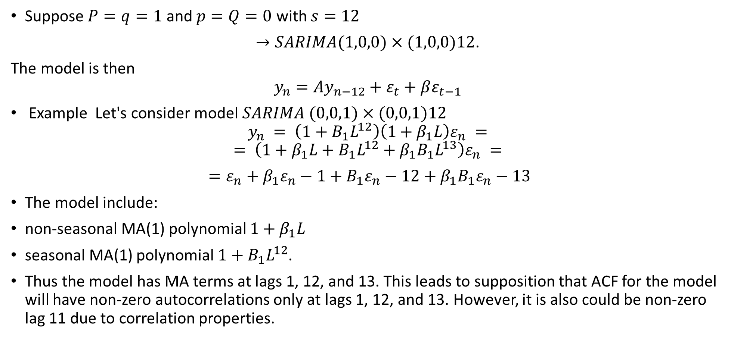
SARIMA Example
Suppose $P=q=1$ and $p=Q=0$ with $s=12$
$→SARIMA(1,0,0)×(1,0,0)12$.
The model is then
$$y_{n}=Ay_{n−12}+ε_{t}+βε_{t−1}$$
Example Let's consider model $SARIMA (0,0,1)×(0,0,1)12$
$$y_{n} = \left(1+B_{1}L^{12}\right)\left(1+β_{1}L\right)ε_{n} =$$
$$= \left(1+β_{1}L+B_{1}L^{12}+β_{1}B_{1}L^{13}\right)ε_{n} =$$
$=ε_{n}+β_{1}ε_{n}−1+B_{1}ε_{n}−12+β_{1}B_{1}ε_{n}−13$
The model include:
non-seasonal MA(1) polynomial $1+β_{1}L$
seasonal MA(1) polynomial $1+B_{1}L^{12}$.
Thus the model has MA terms at lags 1, 12, and 13. This leads to supposition that ACF for the model will have non-zero autocorrelations only at lags 1, 12, and 13. However, it is also could be non-zero lag 11 due to correlation properties.

Slide 29
The algorithm of fitting an SARIMA model
Determination of the order of usual differencing needed to stationarize the series (to exclude the trend).
Checking for seasonal component influence and possibly eliminating seasonality.
Determination of AR and MA order.
Coefficients calculation.
Checking the results on validation tests.
If correct, then predicting, repeat otherwise.
In the explanation above we have notice that seasonal difference make data more stationary.
Then we need to choose the best initial guess about orders of SARIMA.

Slide 30
SARIMA Initial Order selection Rules
Rules of initial orders selection
The correct order 𝑑 is the order of differencing that yields a time series with a noise like behavior
i.e. fluctuates around a well-defined mean value and almost constant scatter,
Use seasonal derivative only in the case of strong seasonal pattern.
check obtained series for stationary by criterions named above.
Then considering ACF and PACF for differenced series.
The numbers of AR terms is determined as the last PACF lag before rapid decreasing from positive values to zero.
The numbers of MA terms is determined as the last ACF lag before rapid increasing from negative values to zero.
Add an SAR term, If ACF is periodically positive.
Beside This the order be derived from PACF.
Look at the number of significant lags, which are the multiples of the season period length.
For example, if the period equals 24 and we see the 24-th and 48-th lags are significant in the PACF, that means the initial P should be 2.
Add an SMA term, If ACF is periodically negative.
Use the same rules of determine the number of lagas as for SAR

Slide 31
SARIMA Order selection. Notes
If your series is slightly under-differenced, add additional AR terms.
If your series is slightly over-differenced,add additional MA terms.
Try to avoid using more than one or two seasonal parameters (SAR + SMA) in the same model, as this is likely to lead to overfitting of the data and / or problems in estimation.
if the series has positive ACF values out to a high lag add differencing order.
The optimal order of differencing is often the order of differencing at which the variance is lowest (you must try to avoid over-differencing).
If the PACF of the differenced series displays a sharp cutoff and/or the lag-1 autocorrelation is positive-i.e., if the series appears slightly "underdifferenced"--then consider adding an AR term to the model. The lag at which the PACF cuts off is the indicated number of AR terms.
If the ACF of the differenced series displays a sharp cutoff and/or the lag-1 autocorrelation is negative-i.e., if the series appears slightly "overdifferenced"-then consider adding an MA term to the model. The lag at which the ACF cuts off is the indicated number of MA terms.

Slide 32
SARIMA Order selection. Notes
If a full (AR and MA) model it is possible for an AR term and an MA term to cancel each other's effects. In this case try a model with one fewer AR term and one fewer MA term-particularly if the parameter estimates in the original model require more than 10 iterations to converge.
If the sum of the AR coefficients is almost exactly 1- you should reduce the number of AR terms by one and increase the order of differencing by one.
If the sum of the MA coefficients is almost exactly 1- you should reduce the number of MA terms by one and reduce the order of differencing by one.
If the series has a strong and consistent seasonal pattern, then you can use an order of seasonal differencing.
Use seasonal difference (D) for non-stationary seasonality.
If the series ACF has periodic positive bursts add seasonal order to SAR.
If the series ACF has periodic negative bursts add seasonal order to SMA.

Slide 33
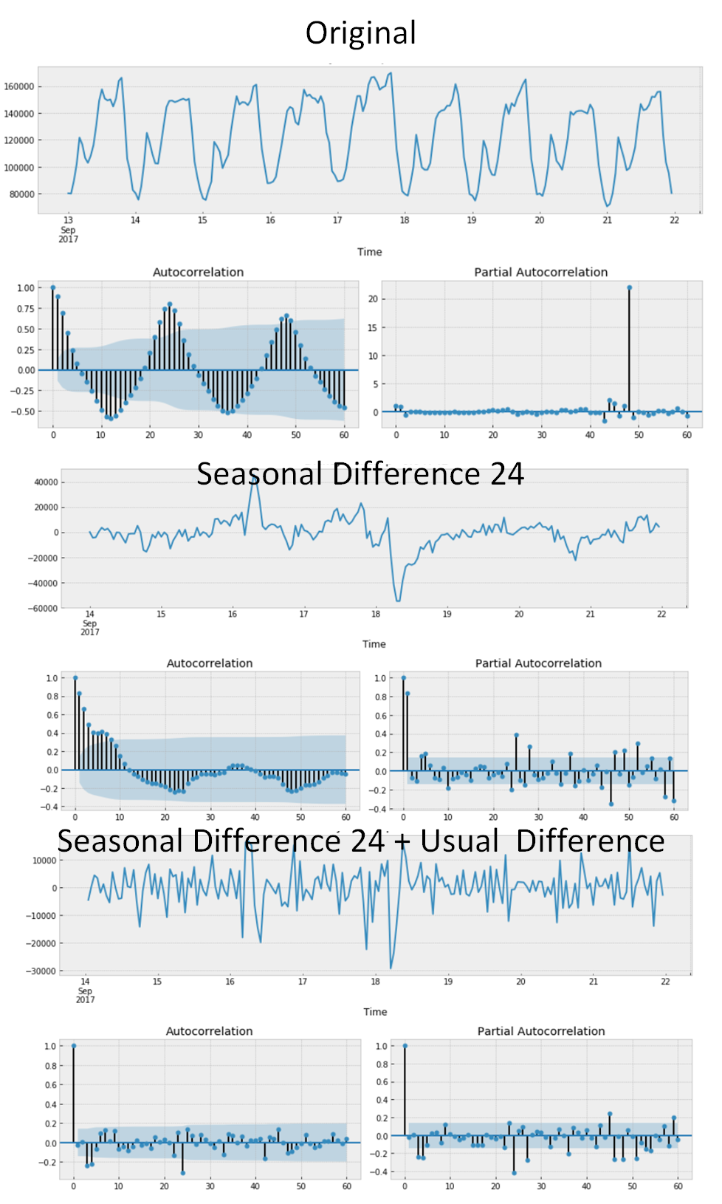
SARIMA Order selection. Example
p is most probably 4 since it is the last significant lag on the PACF, after which, most others are not significant.
d equals 1 because we had first differences
q should be somewhere around 4 as well as seen on the ACF
P might be 2, since 24-th and 48-th lags are somewhat significant on the PACF
D again equals 1 because we performed seasonal differentiation
Q is probably 1. The 24-th lag on ACF is significant while the 48-th is not.

Slide 34

SARIMA Order selection. Example

Slide 35
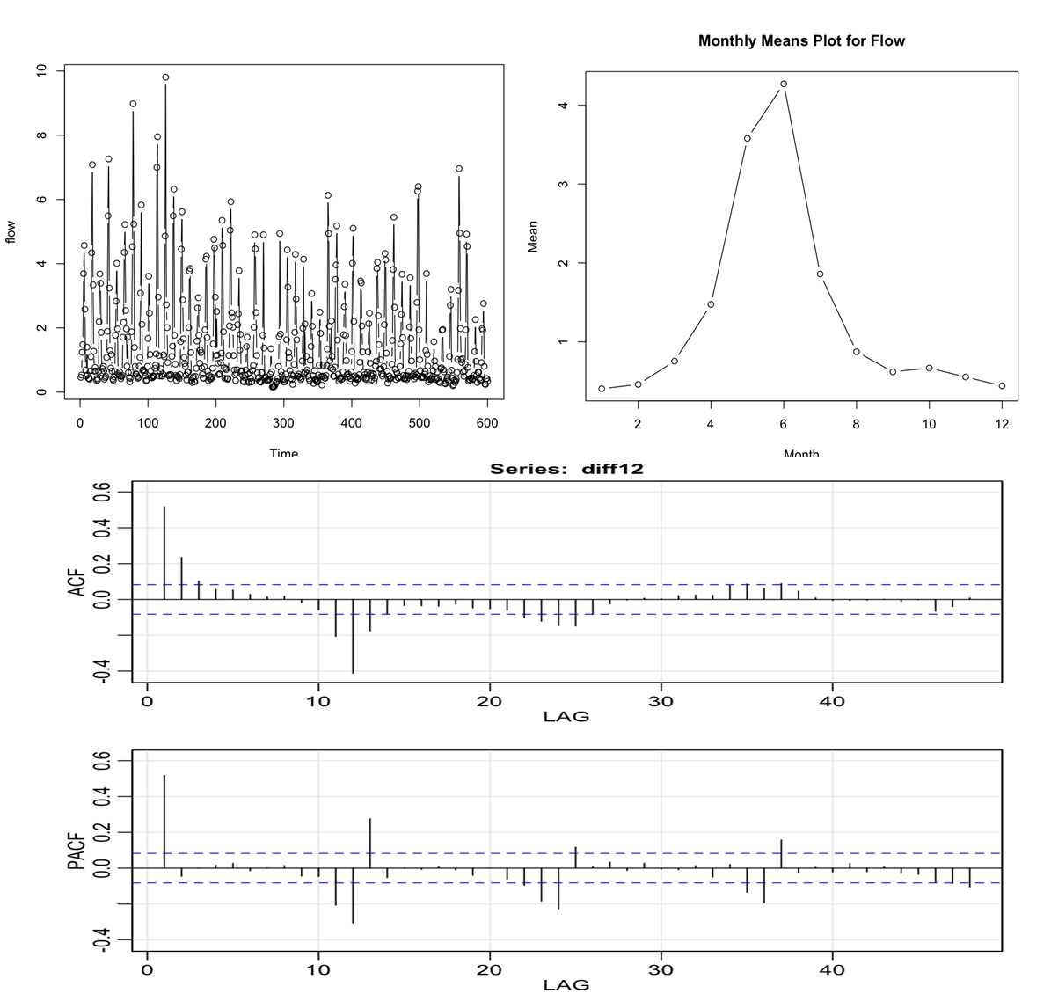
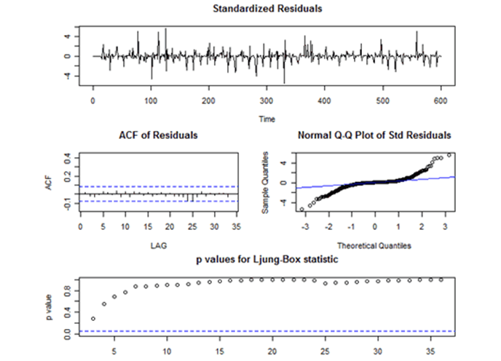
SARIMA Order selection. Example
The PACF shows a clear spike at lag 1 and not much else until about lag 11. This is accompanied by a tapering pattern in the early lags of the ACF. A non-seasonal AR(1) may be a useful part of the model.
The PACF has significant lags at 12, 24, 36 and so on. This is seams that we need to set seasonal MA(1).

Slide 36
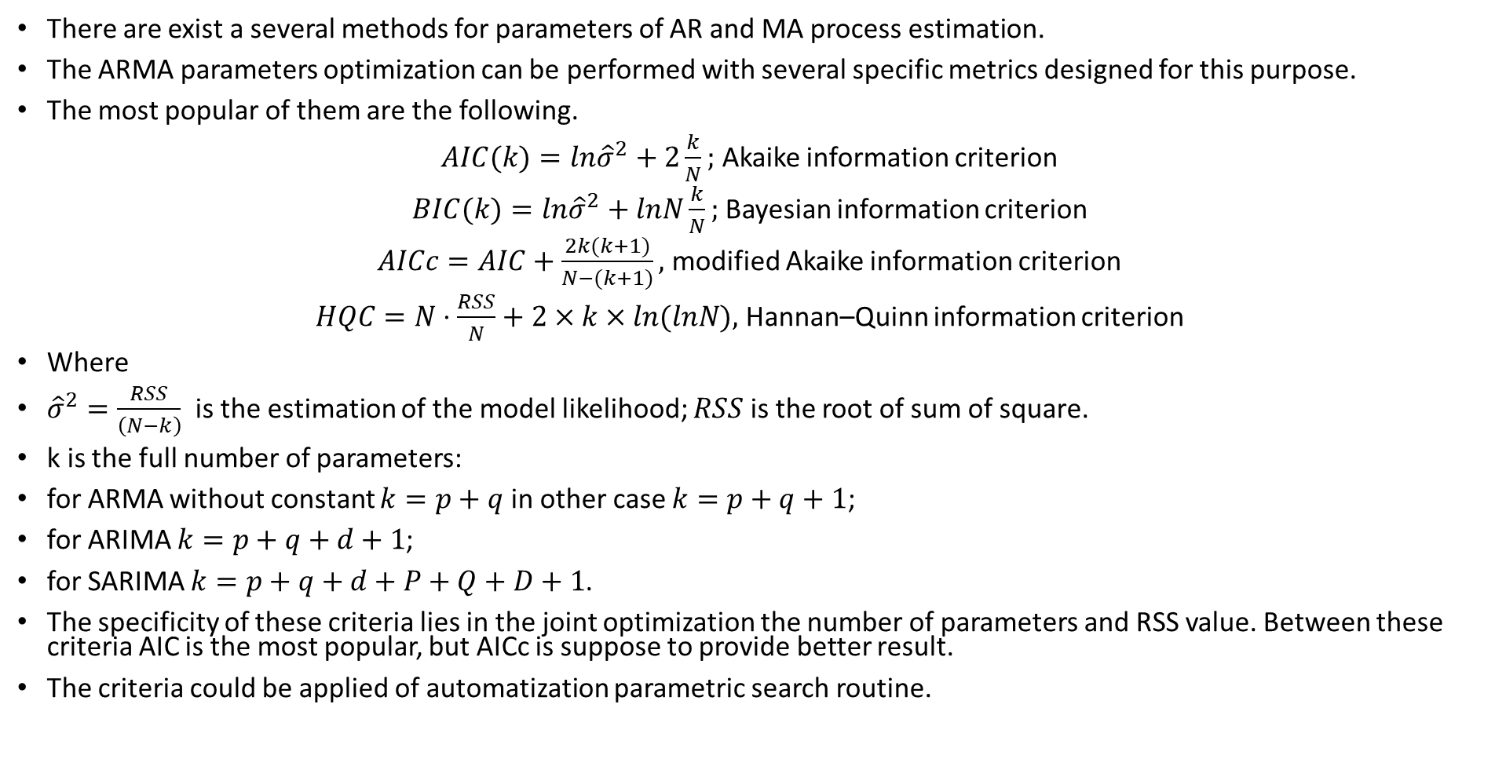
ARMA coefficient estimation
There are exist a several methods for parameters of AR and MA process estimation.
The ARMA parameters optimization can be performed with several specific metrics designed for this purpose.
The most popular of them are the following.
$AIC(k)=ln{\hat{σ}}^{2}+2\frac{k}{N};$ Akaike information criterion
$BIC(k)=ln{\hat{σ}}^{2}+lnN\frac{k}{N};$ Bayesian information criterion
$AICc=AIC+\frac{2k(k+1)}{N−(k+1)},$ modified Akaike information criterion
$HQC=N⋅\frac{RSS}{N}+2×k×ln(lnN),$ Hannan–Quinn information criterion
Where
${\hat{σ}}^{2}=\frac{RSS}{\left(N−k\right)}$ is the estimation of the model likelihood; $RSS$ is the root of sum of square.
k is the full number of parameters:
for ARMA without constant $k=p+q$ in other case $k=p+q+1$;
for ARIMA $k=p+q+d+1$;
for SARIMA $k=p+q+d+P+Q+D+1$.
The specificity of these criteria lies in the joint optimization the number of parameters and RSS value. Between these criteria AIC is the most popular, but AICc is suppose to provide better result.
The criteria could be applied of automatization parametric search routine.

Slide 37
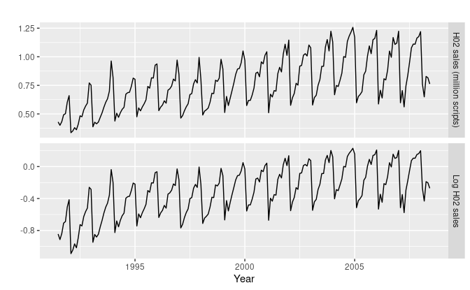
ARMA coefficient estimation Example
Example: sales prediction. On the original plot there is a small increase in the variance with the level, so we take logarithms to stabilize the variance.
The data are strongly seasonal and obviously non-stationary, so seasonal differencing will be used with seasonality 12.
It is not clear at this point whether we should do another difference or not. We decide not to, but the choice is not obvious.

Slide 38
ARMA coefficient estimation Example
Example: sales prediction. On the original plot there is a small increase in the variance with the level, so we take logarithms to stabilize the variance.
The variations of parameters decline the first guess - it is better to use ARIMA(3,0,1)(0,1,2)12 model.
On the obtained plot there are spikes in the PACF at lags 12 and 24, but nothing at seasonal lags in the ACF. This may be suggestive of a SAR(2) term. In the non-seasonal lags, there are three significant spikes in the PACF, suggesting a possible AR(3) term. The pattern in the ACF is not indicative of any simple model.
This initial analysis suggests that a possible model for these data is an ARIMA(3,0,0)(2,1,0)12. The variations of parameters decline the first guess - it is better to use ARIMA(3,0,1)(0,1,2)12 model.

Slide 39
ARMA coefficient estimation Example
Example: sales prediction. On the original plot there is a small increase in the variance with the level, so we take logarithms to stabilize the variance.
Then it is need to estimate the residuals
Then it is need to estimate the residuals There are a few significant spikes in the ACF thus the model fails the Ljung-Box test. The model can still be used for forecasting, but the prediction intervals may not be accurate due to the correlated residuals.

Slide 40
Other SARIMA-Like Models
Beside discussed above SARIMA model it usually considered a several other:
SARIMAX - SARIMA model with the exogenous addition factors.
Extra factors
Regression + ARIMA (Regression forecasting results could be exogenous factors)
ARIFMA- ARIMA model with using fractional derivatives (and fractional integration).
VAR, VMA, VARMA - multivariate models.
NAR, NARX, NARMA -Non-linear AR (NAR), Non-linear AR with exageneous factors (NARX), non-linear ARMA (NARMA) and e.t.c.
AR-NET (with regularization or different loss function, solving the equation by Grad.Desc).
TBATS or any other complex combined models
ARCH, GARCH
So-on

Slide 41
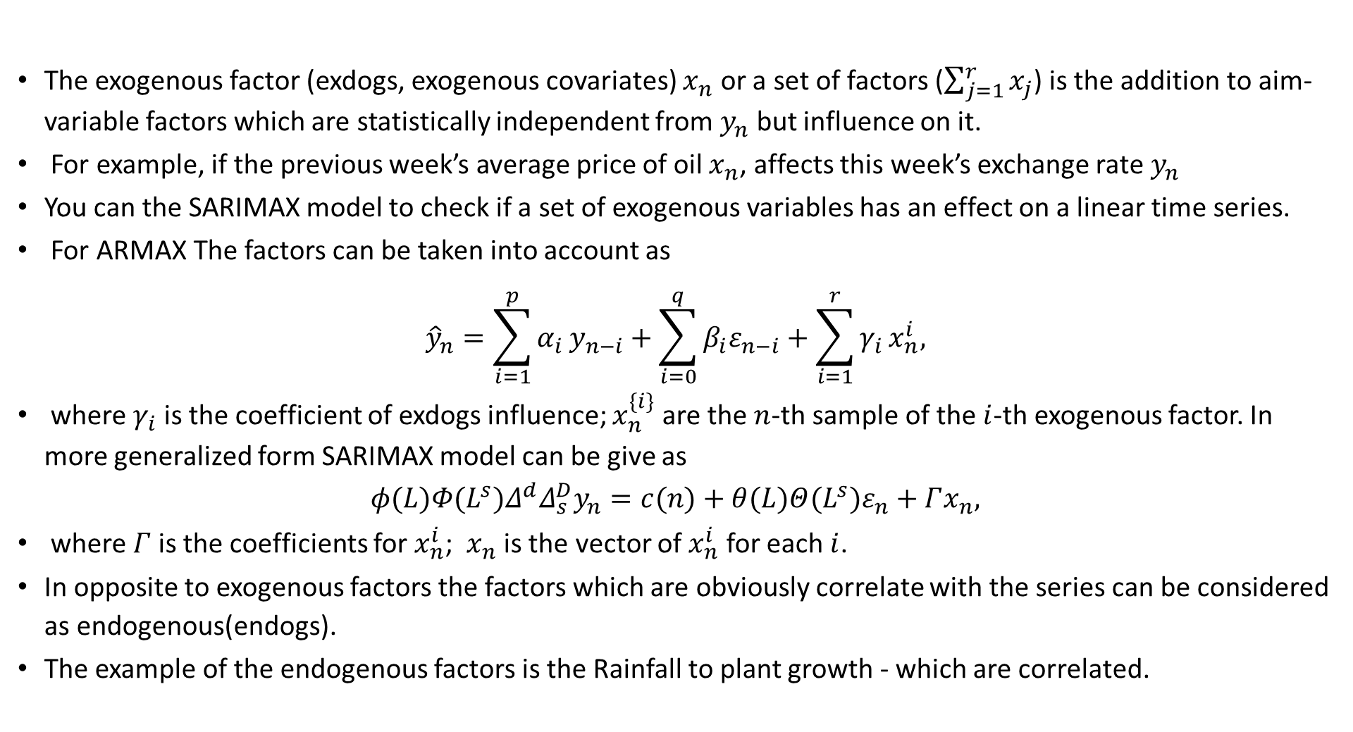
Exogenous factor (SARIMAX)
The exogenous factor (exdogs, exogenous covariates) $x_{n}$ or a set of factors ($\sum_{j=1}^{r}{x_{j}}$) is the addition to aim-variable factors which are statistically independent from $y_{n}$ but influence on it.
For example, if the previous week’s average price of oil $x_{n}$, affects this week’s exchange rate $y_{n}$
You can the SARIMAX model to check if a set of exogenous variables has an effect on a linear time series.
For ARMAX The factors can be taken into account as
$${\hat{y}}_{n}=\sum_{i=1}^{p}{α_{i}}y_{n−i}+\sum_{i=0}^{q}{β_{i}ε_{n−i}}+\sum_{i=1}^{r}{γ_{i}}x_{n}^{i},$$
where $γ_{i}$ is the coefficient of exdogs influence; $x_{n}^{\{i\}}$ are the $n$-th sample of the $i$-th exogenous factor. In more generalized form SARIMAX model can be give as
$$φ(L)Φ(L^{s})Δ^{d}Δ_{s}^{D}y_{n}=c(n)+θ(L)Θ(L^{s})ε_{n}+Γx_{n},$$
where $Γ$ is the coefficients for $x_{n}^{i}$; $x_{n}$ is the vector of $x_{n}^{i}$ for each $i$.
In opposite to exogenous factors the factors which are obviously correlate with the series can be considered as endogenous(endogs).
The example of the endogenous factors is the Rainfall to plant growth - which are correlated.

Slide 42
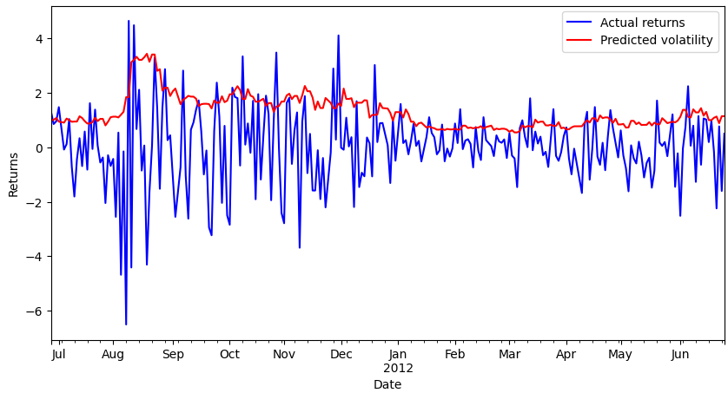
ARCH model

